Slide 1
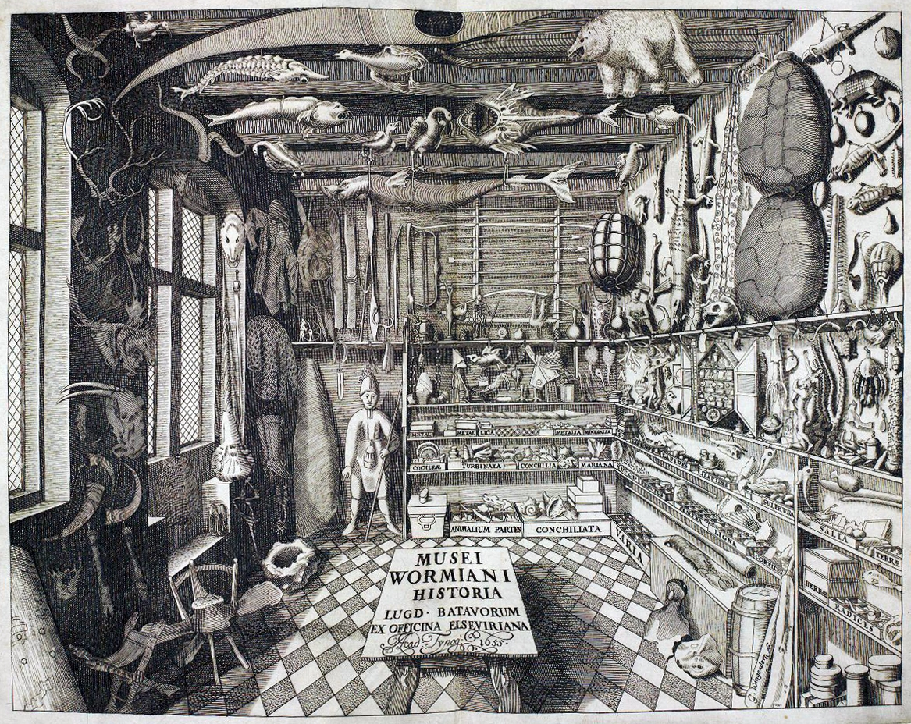
HISTORY 1310 Science and Technology in World Civilization
Dr. E. A. (Allen) Driggers
Tennessee Technology University
Department of History

Slide 2

What did you do this Summer?
Defended my dissertation, “Boundary Stones: Morbid Concretions and the Chemistry of Early Nineteenth Century Chemistry”
Graduated with a Doctorate in History (STE) from the University of South Carolina
Daughter Born August 10, 2015

Slide 3
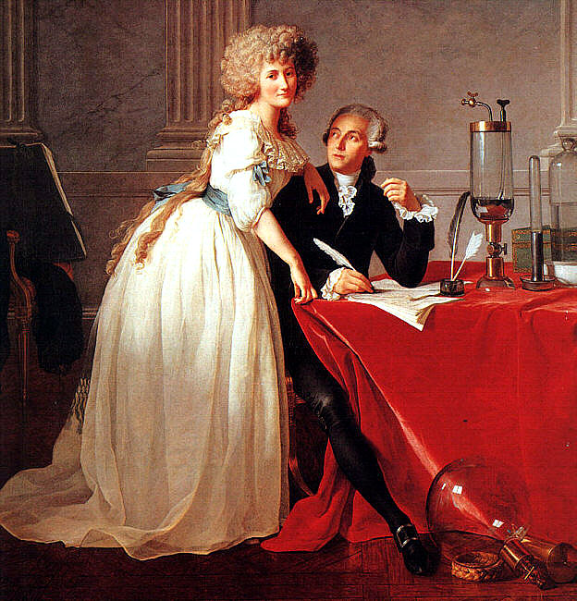
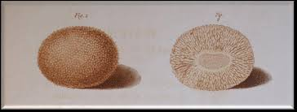
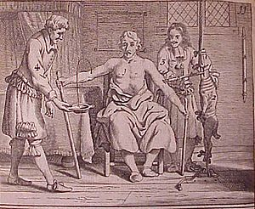

Slide 4

What did you do this Past Fall?
Taught here at Tech :-D!
Gave a presentation to the College of Engineering
Published a review in Ambix
Applied for a A LOT of grants!
I’m preparing a manuscript for submission into a major research journal

Slide 5
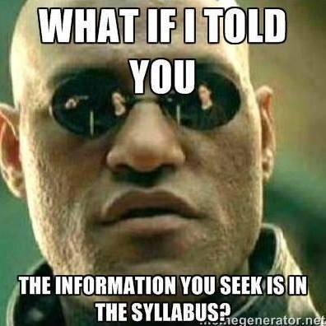

The Syllabus

Slide 6
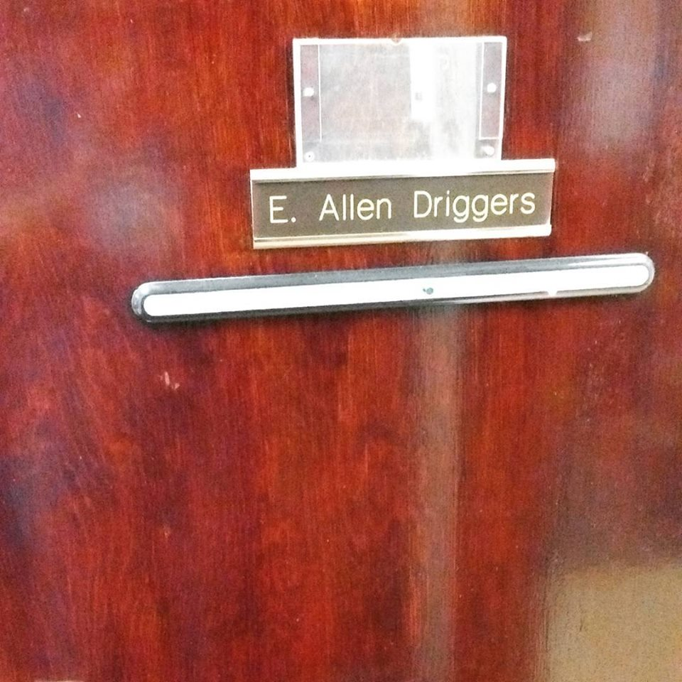
Questions?
E-mail me at edriggers@tntech.edu
Come by my office hours
Tuesday through Thursday from 4:30-6
Or make an appointment through e-mail
Some things to discuss during office hours:
Problems reading and retaining information from lecture or textbook
Questions about grades, performance, participation, attendance, &c.
Go over a test or a paper
Recommendations about improvement

Slide 7
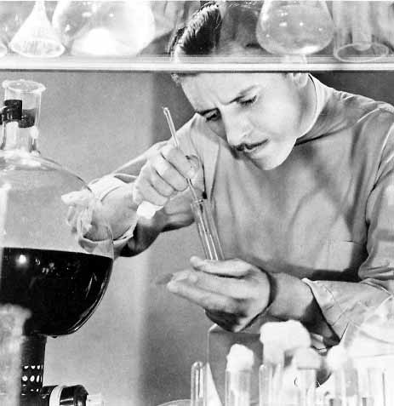
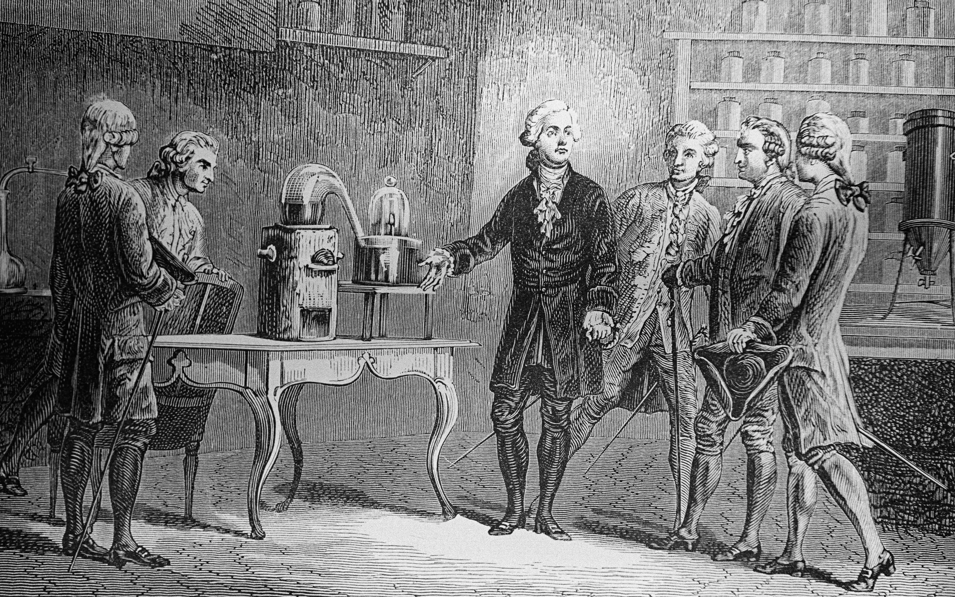
“The Scientist”

Slide 8
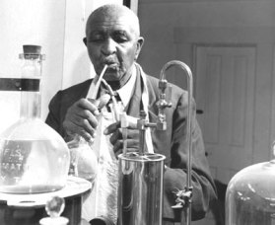
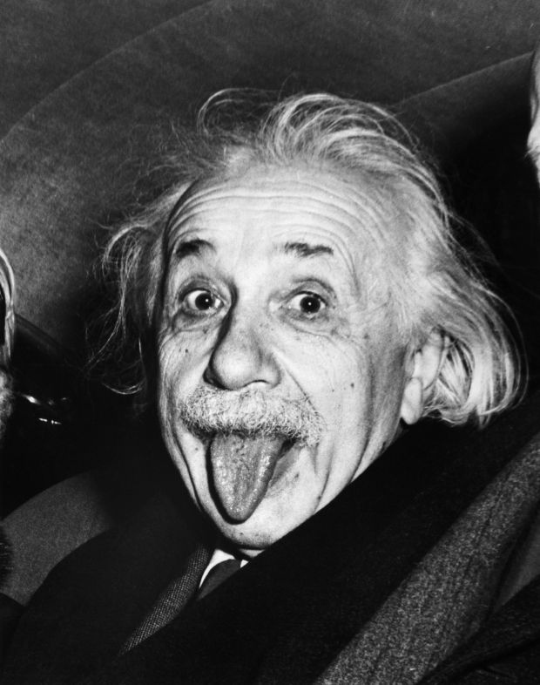
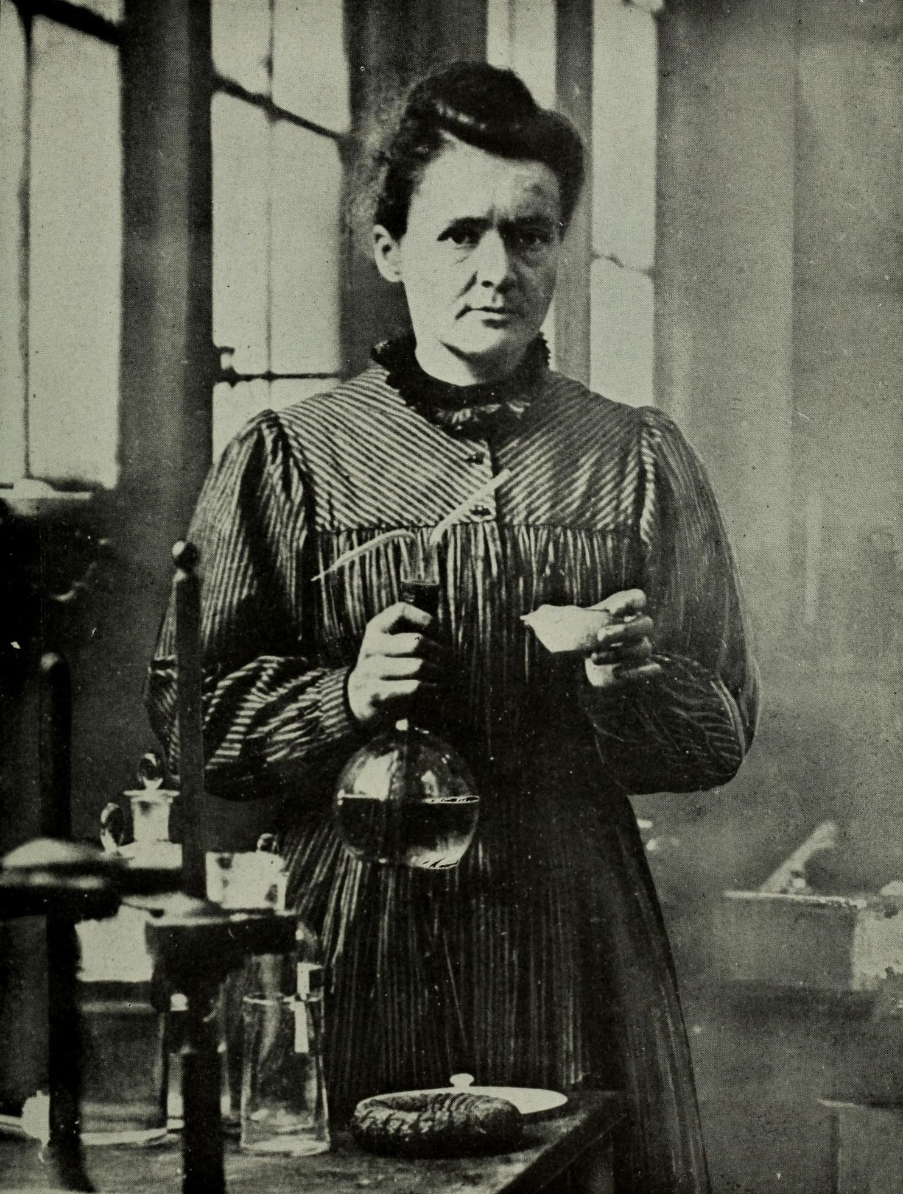
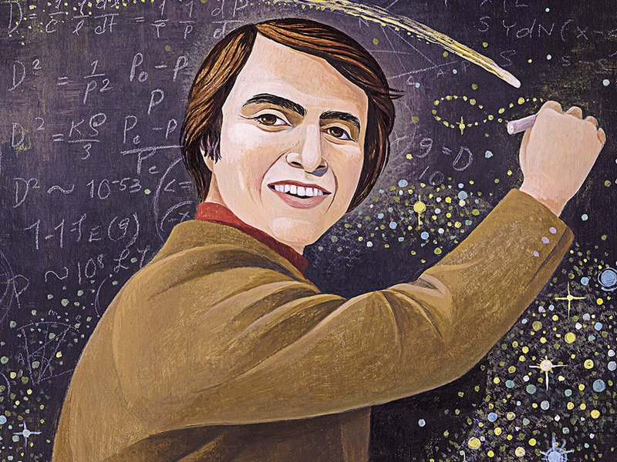
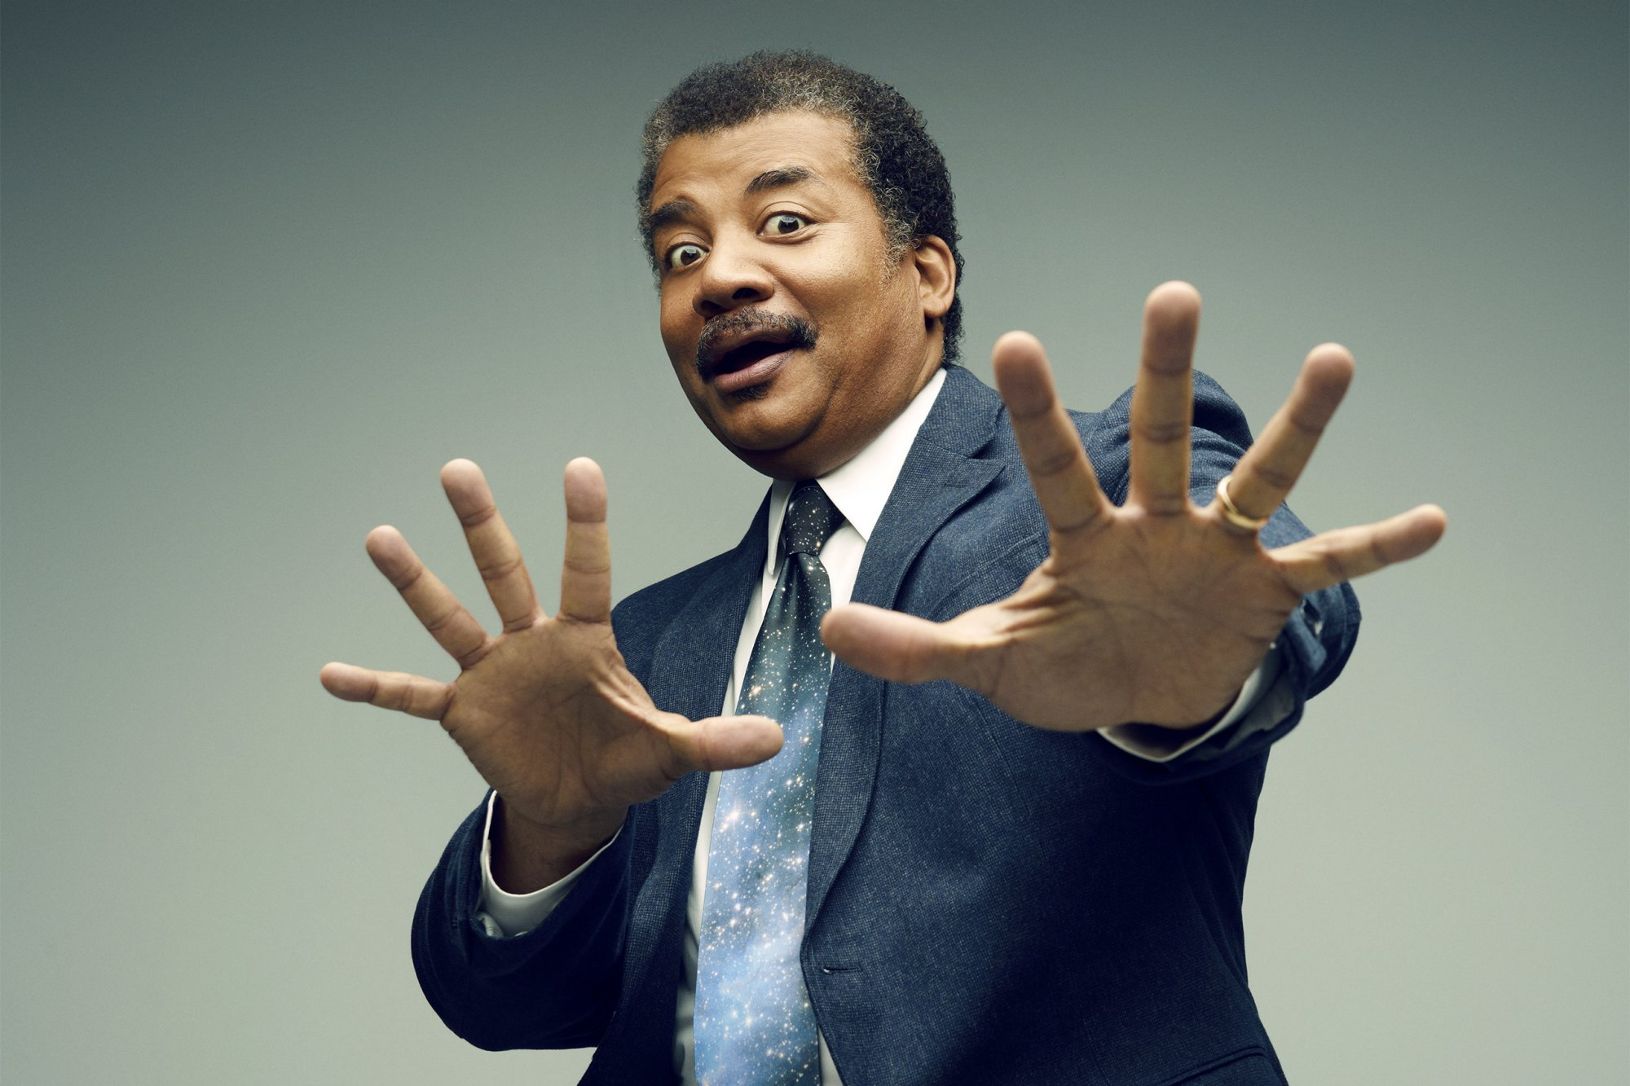
Scientists Are Lots of Different People, Personalities &c.

Slide 9
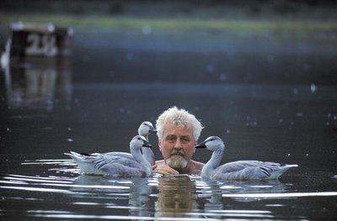
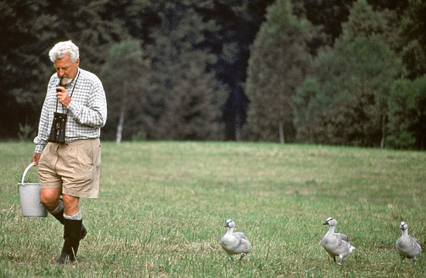
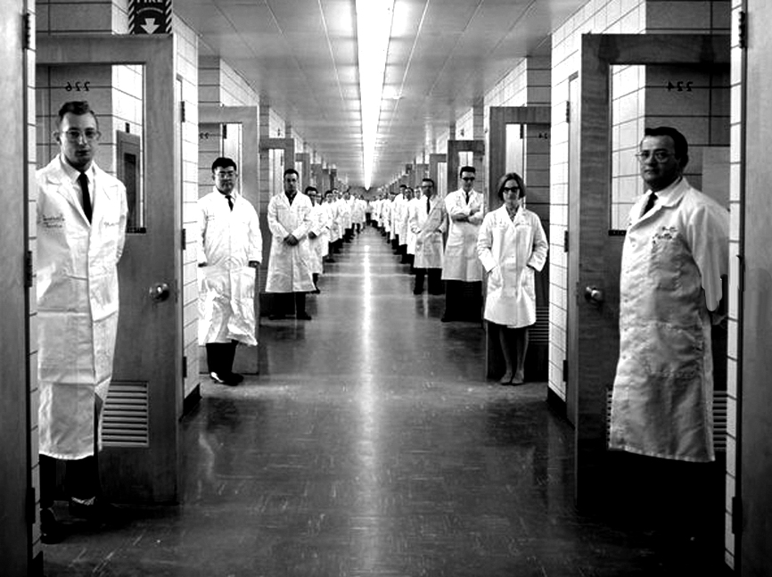
Where Does Science Take Place?

Slide 10
Lecture 1
What is the meaning of science?
What is the use of science?
Are there ways that science can be used improperly?
Is science value free?
How do non-epistimic values figure into scientific investigations?
What are the role of contextual values in science?
Whose values will impact scientific work?

Slide 11
What Do I mean By Values???
Epistimic-Traditionally means values in the internal processes of science—like measurement, quantification, “Testable”
Non-Epistimic-Means those not in the internal process, often effecting the conceptualization of questions and interpretation of “data,” things like experiences, psychological worries, political values, ideas about race, gender &c.
Objectivity is a changing standard throughout history!

Slide 12
Traditional Conception of Scientific Investigation
Scientists→ Observe phenomena→ Measure it →Understand and make products; control phenomena; offer recommendations
Who are scientists?
What is deemed phenomena?
What counts as proper measurement?
Why are conclusions drawn, verified, and communicated to professionals and the public(s)?
Is science objective?
What questions are we as a society comfortable with asking?
What is the role of ethics in scientific investigations?

Slide 13
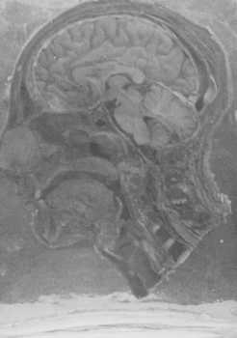
Nazi Medical Experimentation and the Body
Examples include, but not limited to:
High Altitude Experiments
Drug experiments
Freezing Water

Slide 14

Drug Testing and Children
Case of Anti-depressants and adolescents
Re-branding of drugs for profits
Arthritis

Slide 15
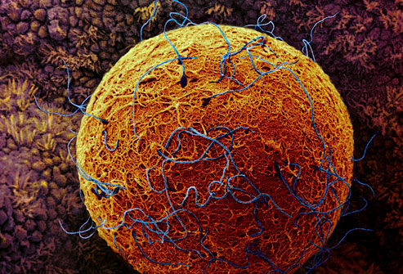

Conception and Understanding Life
The Sperm and Egg Model
Microvilli on the surface of the egg

Slide 16
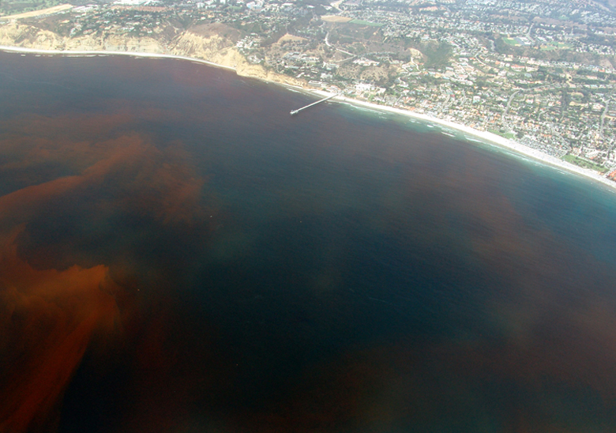
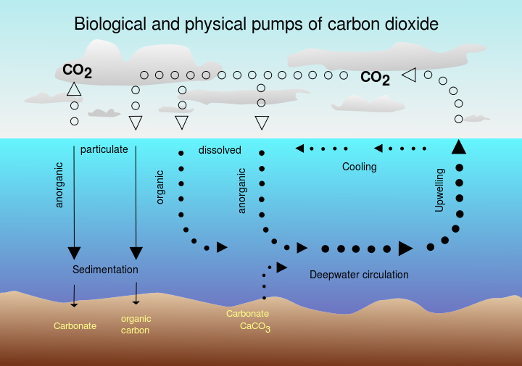
Interventions and the Environment
Iron Sulfate (Fertilization) Dumping into the Ocean

Slide 17
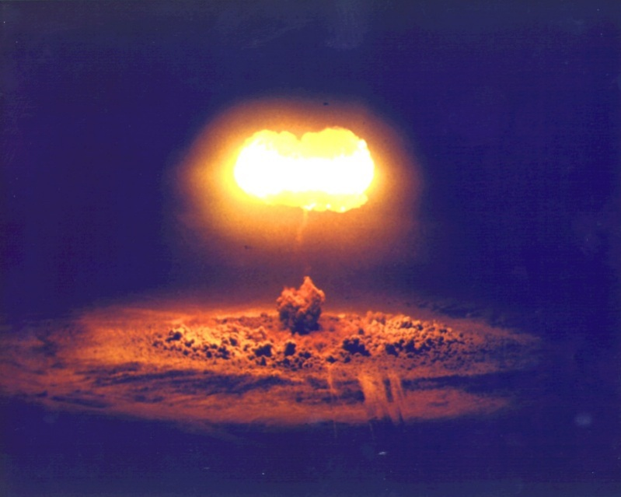
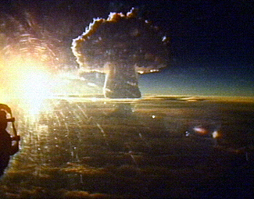
High Altitude Nuclear Explosions (HANES)

